Slide 1

Brookings Institute, 2025:
As AI models begin to handle underwriting, compliance, and asset allocation, the traditional architecture of financial work is undergoing a fundamental shift.
As job descriptions evolve, so does the definition of financial talent. Excel is no longer a differentiator. Python is fast becoming the new Excel.
But technical skills alone will not cut it. The most in demand profiles today are those that speak both AI and finance.

Slide 2
Derek Waldron, JP Morgan Chief Analytics Officer, CNBC, September 30, 2025 :
What we're working towards is that every employee will have their own personalized AI assistant; every process is powered by AI agents, and every client experience has an AI concierge.
You'll still have people at the top who are managing and have relationships with clients, but many, many of the processes underneath are now being done by AI systems.
Workers would shift from being creators of reports or software updates, or 'makers' ... to 'checkers' or managers of AI agents doing that work.

Slide 3

Aaron Linsky, CTO, AIA Labs at
We've been developing capabilities powered by Claude since 2023 within AIA Labs.
Claude powered the first versions of our Investment Analyst Assistant, which streamlined our analysts' workflow by generating Python code, creating data visualizations, and iterating through complex financial analysis tasks with the precision of a junior analyst.

Slide 4
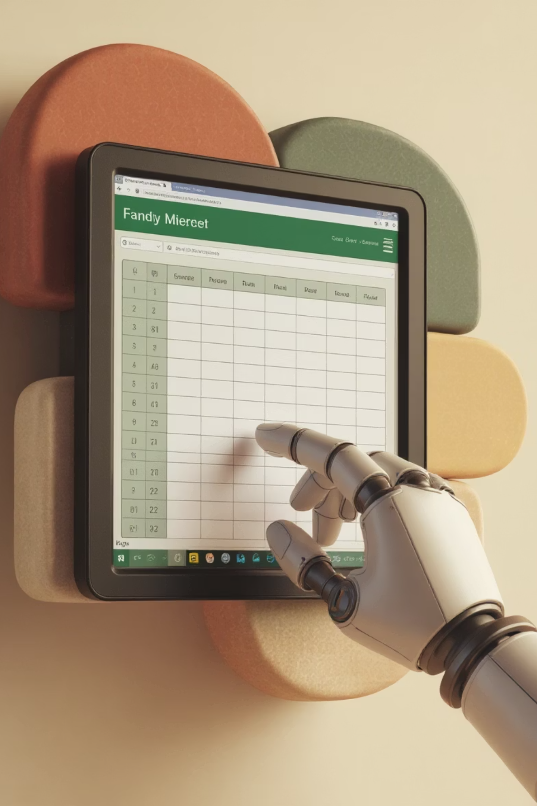
Claude became able to generate fully functioning, nicely formatted Excel workbooks in September 2025.
Prompt: Read the uploaded HBS case (Valuing Wal-Mart 2010). Ignore the valuation method described in the case. Do a two-stage DCF valuation. Document your assumptions and your reasons for them. Create a professionally formatted Excel workbook.

Slide 5
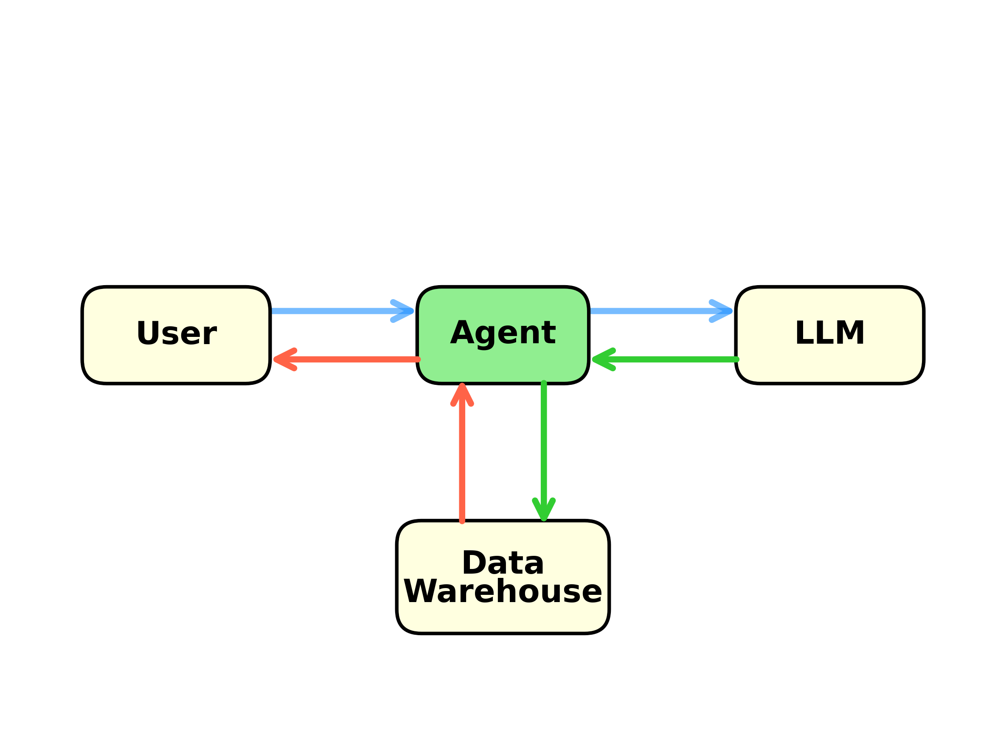
Database Agent
Could attach more tools. For example, Python to analyze data. Then Output → User

Slide 6

A Vibe-Coded Database Agent
Visit data-portal.rice-business.org
Example prompt:
Get TSLA's ROE by quarter on a trailing 4-quarters basis for Q1 2020 through Q3 2025 from the Rice stock database.

Slide 7
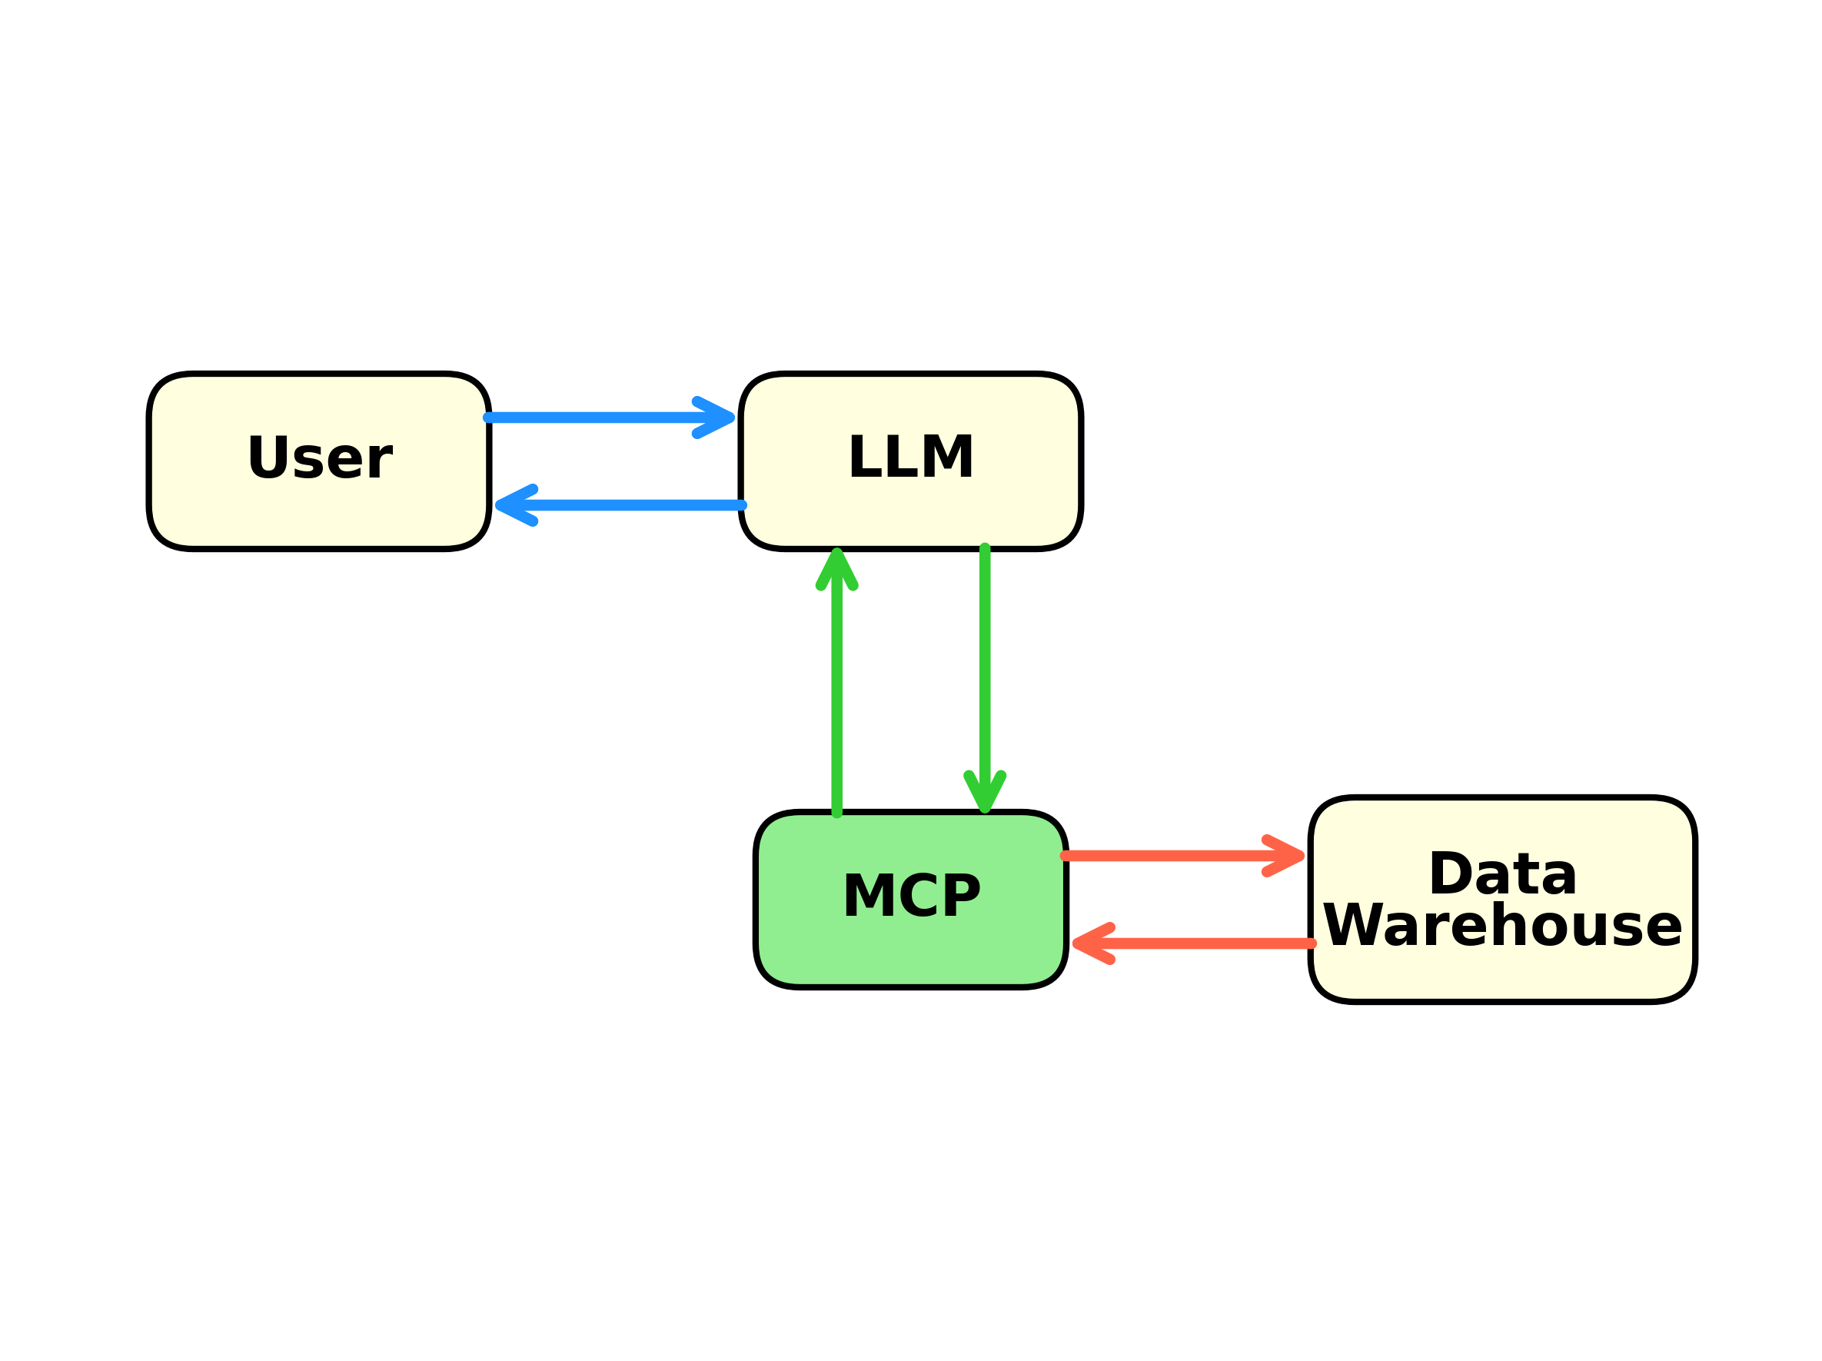
Model Context Protocol (Nov, 2024)
Agent logic embedded in MCP server (local or cloud) and instructions to LLM
User experience is
simplified. Use single chatbot for everything.
Backbone of OpenAI’s Apps

Slide 8
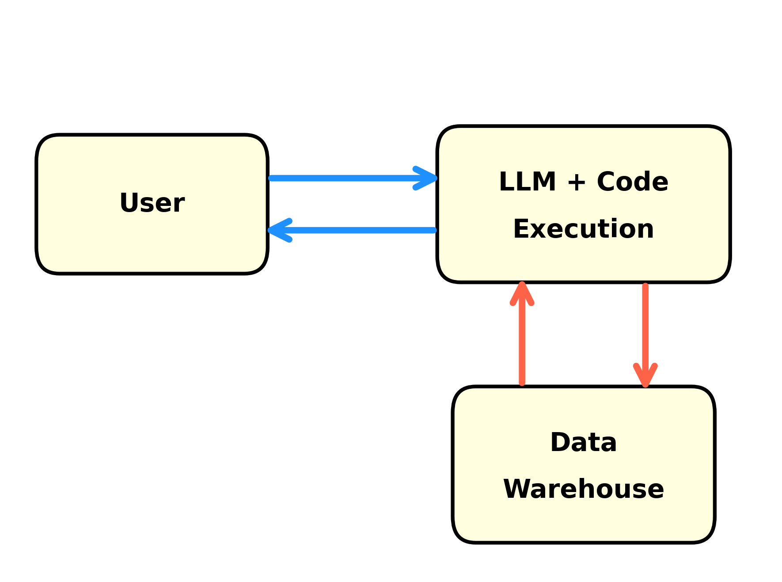
Claude Skills (10-16-2025)
User chats with Claude as with MCP
Agent logic embedded in
Skill – instructions that Claude reads when needed + Python scripts it can execute
Developer experience is simplified
Claude has a Skill for
creating Skills!

Slide 9

Vibe Coded Claude Skill
I created a skill for the Rice stock database for MGMT 638: Quantitative Equity Investing
Claude Prompt: Using the Rice database, get monthly returns, momentum, pb, and roe from 10Ks for all stocks since Jan 1, 2020.

